Slide 1

AJIO Customer Shopping Behavior Analysis
Transactional insights from 3,900 purchases across categories, segments, and subscription behavior.

Slide 2
Dataset at a Glance
3,900
18
Transactions
Features
Rows in dataset
Columns per record
37
50
Missing Values
Locations
In Review Rating
Unique customer regions
Key features: demographics, purchase details, shopping behavior, and subscription status.

Slide 3

Python: Data Preparation
Clean
Imputed missing Review Ratings using category medians
Standardize
Renamed columns to snake_case
Engineer
Created age_group & purchase_frequency_days
Load
Connected to PostgreSQL for SQL analysis

Slide 4
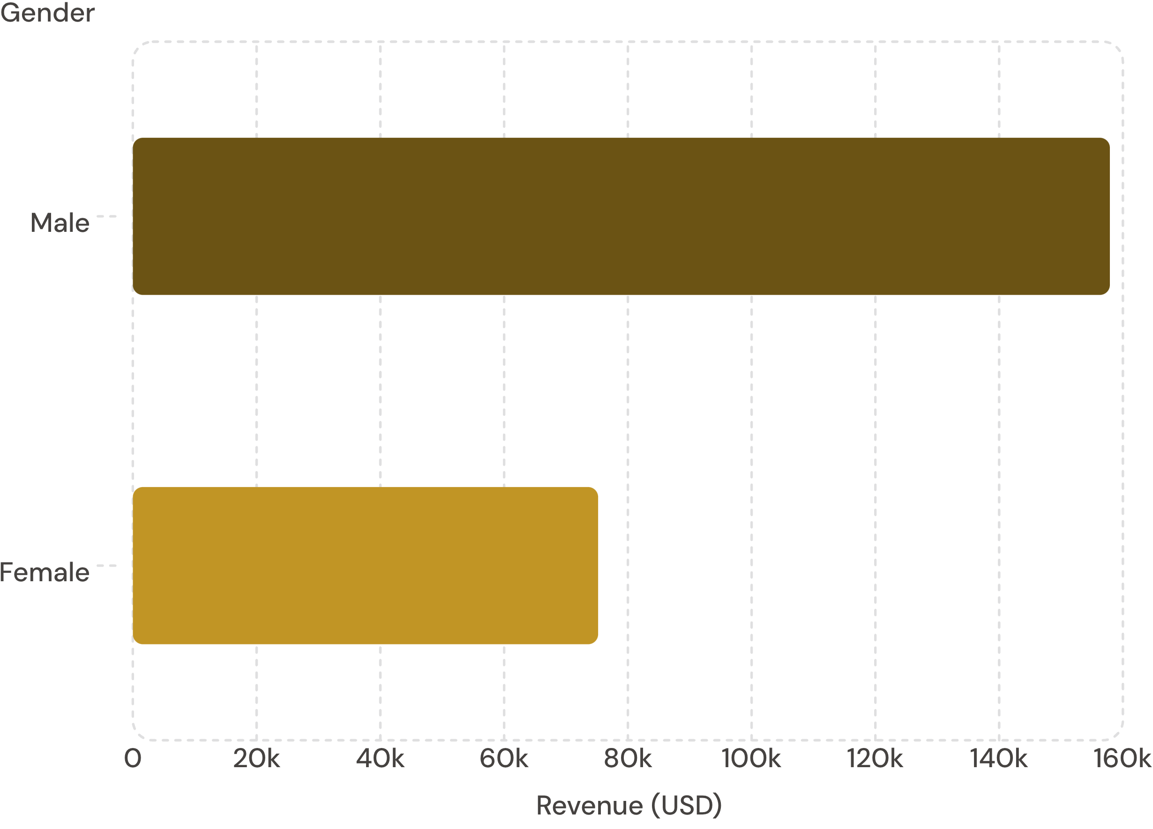
Revenue by Gender
Key Finding
Male customers generated 2.1× more revenue than female customers — $157,890 vs. $75,191.

Slide 5
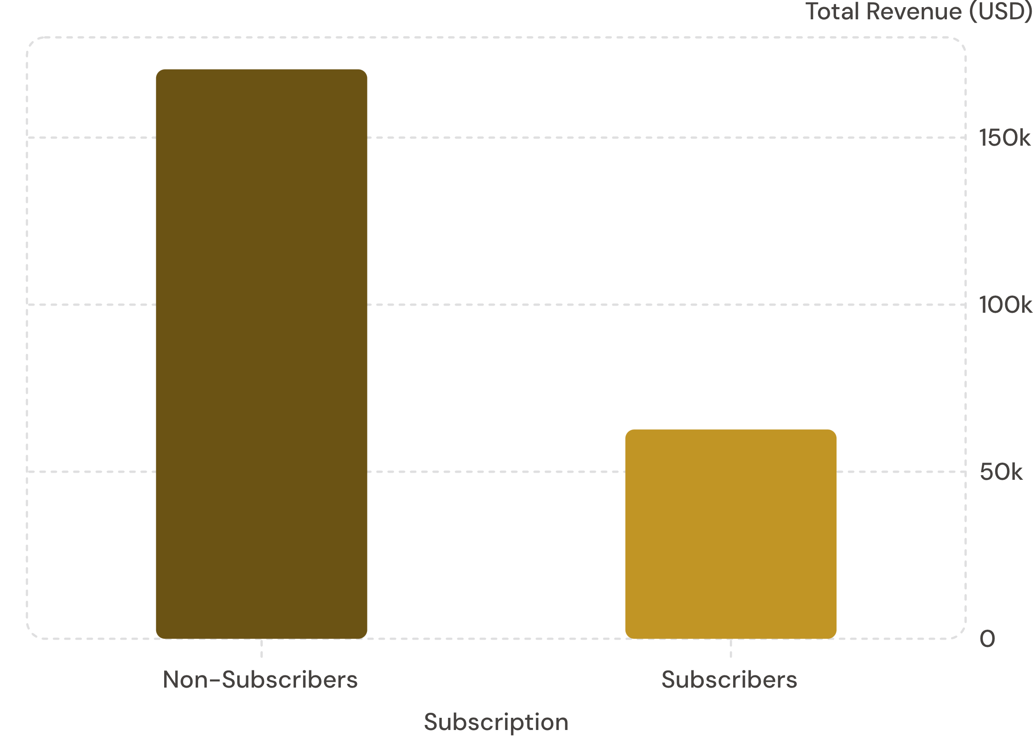
Subscribers vs. Non-Subscribers
Insights
73% of customers are non-subscribers
Subscribers: 1,053 customers, avg spend $59.49
Non-subscribers: 2,847 customers, avg spend $59.87

Slide 6
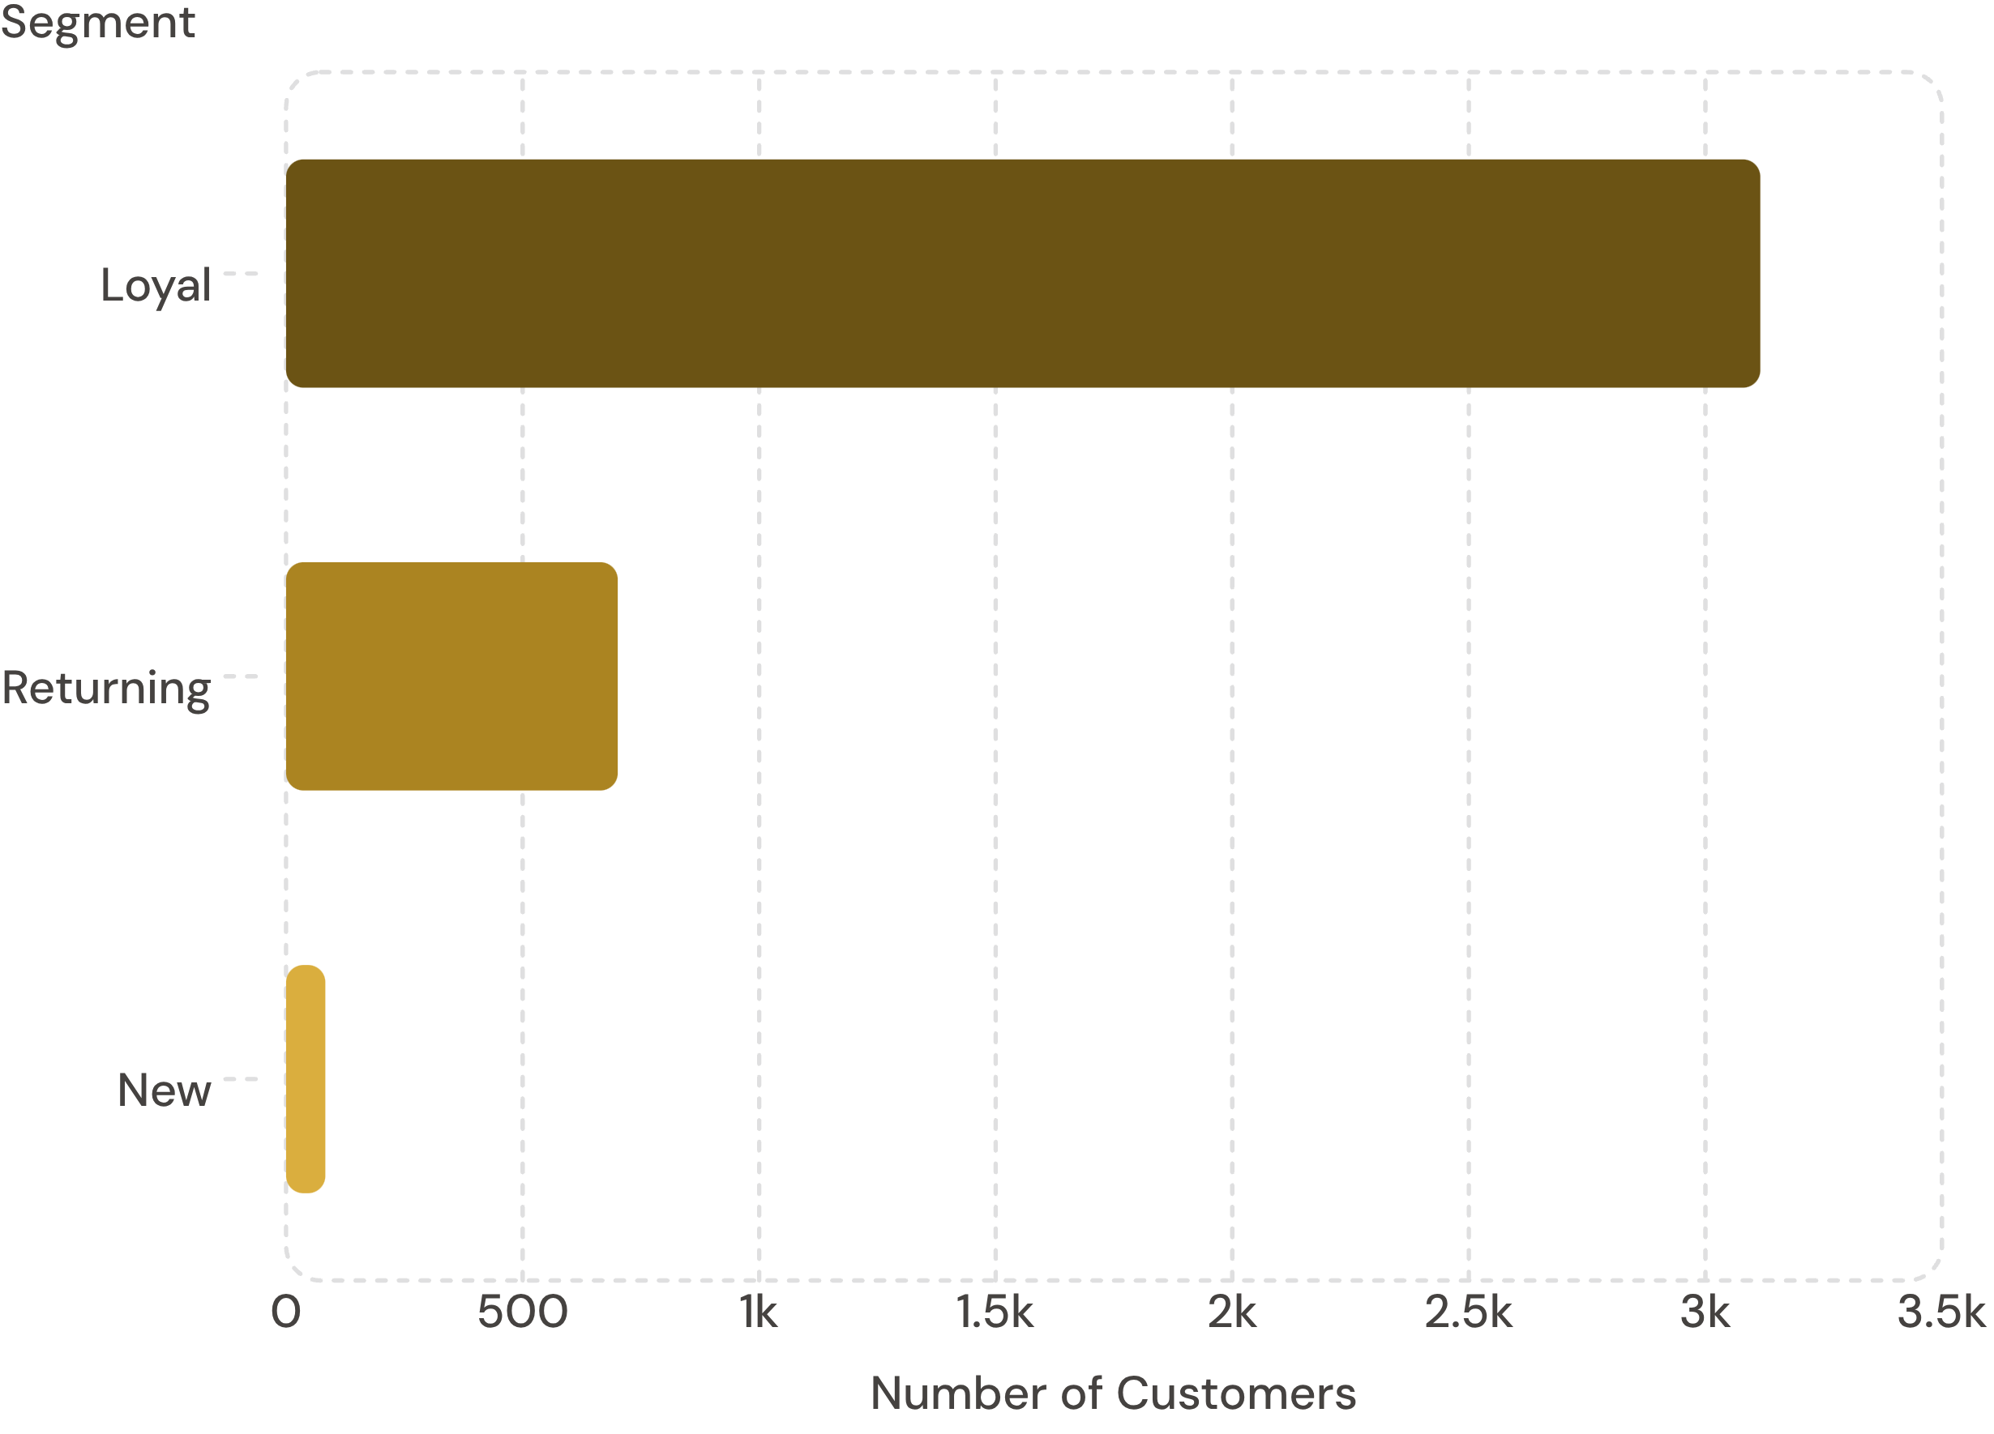
Customer Segmentation
Segment Breakdown
Based on purchase history:
Loyal — 3,116 customers
Returning — 701 customers
New — 83 customers
958 repeat buyers (>5 purchases) are subscribed.

Slide 7
Top Products & Categories
Top 3 Products by Category
Highest-Rated Products
Gloves — 3.86
Sandals — 3.84
Boots — 3.82
Hat — 3.80
Skirt — 3.78
Category | Product | Orders
Accessories | Jewelry | 171
Clothing | Blouse | 171
Footwear | Sandals | 160
Outerwear | Jacket | 163

Slide 8
Discounts & Shipping
Most Discounted Products
Shipping Type — Avg Purchase
Express: $60.48
Standard: $58.46
Product | Discount Rate
Hat | 50%
Sneakers | 49.66%
Coat | 49.07%
Sweater | 48.17%
Pants | 47.37%
839 high-spenders used discounts above average purchase amount.

Slide 9
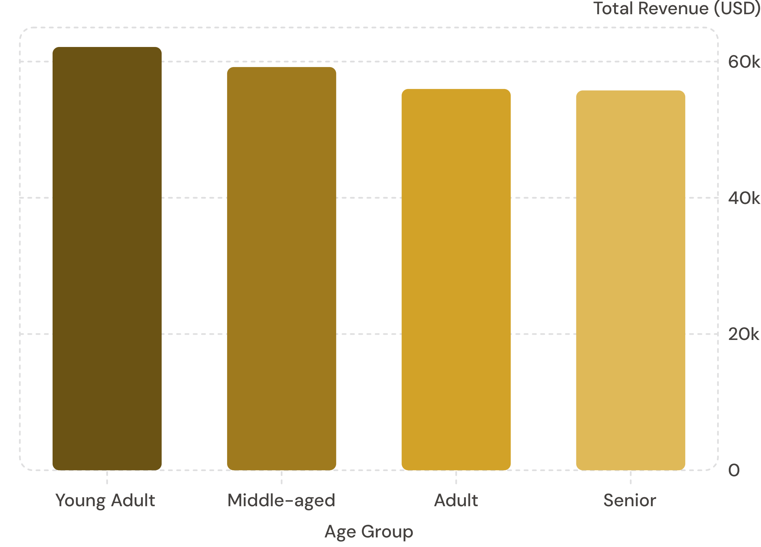
Revenue by Age Group
Key Takeaway
Young Adults lead revenue at $62,143. Revenue is relatively balanced across all age groups.

Slide 10





Business Recommendations
Boost Subscriptions
Promote exclusive subscriber benefits
Loyalty Programs
Reward repeat buyers to grow the Loyal segment
Review Discounts
Balance sales boosts with margin control
Targeted Marketing
Focus on high-revenue age groups & express shippers

